Slide 1
INNOVACIÓN
Sergio Flores- ZEDE DEL LITORAl

Slide 2
The build-up of innovation capacities has played a central role in the growth dynamics of successful developing countries. ... In earlier stages, incremental innovation is often associated with the adoption of foreign technology, and social innovation can improve the effectiveness of business and public services.
Innovation for Development - OECD
Productivity accounts for half of the differences in GDP per capita across countries despite the vast potential returns to innovation, developing countries invest far less, measured along a variety of dimensions, than advanced countries. Firms and governments appear to be leaving billions of dollars on the table in forgone productivity growth and lost competitiveness. Indeed, policy advice to move into production baskets thought to be more growth-friendly misses the critical point that countries unable to innovate in their present industries are unlikely to do so in new industries.
Innovación

Slide 3
Despite the vast potential returns to innovation, this study documents that developing countries do far less innovation, measured along a variety of dimensions, than advanced countries. This we term the “Innovation Paradox.” Developing country firms and governments appear to be leaving billions of dollars on the table, uncollected. Indeed, Pritchett (1997), among others, documents a “Great Divergence” of the last two centuries where, instead of poor countries catching up, with few exceptions rich countries continue to pull ahead. Comin and colleagues (Comin and Hobijn 2004; Comin and Ferrer 2013) argue that it is precisely the differences in the rate of adoption of new technologies that drives the magnitude of the Great Divergence.

Slide 4
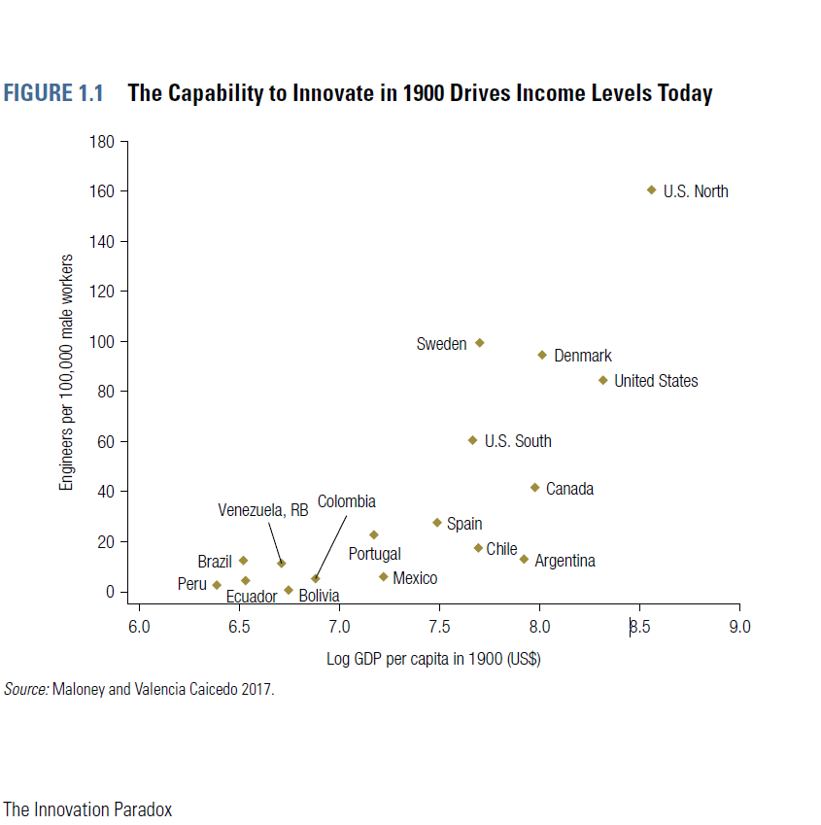

Slide 5
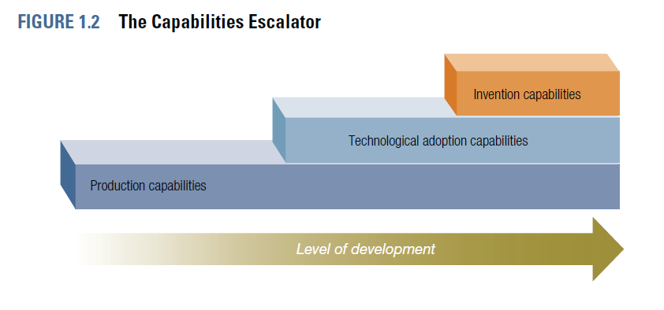

Slide 6
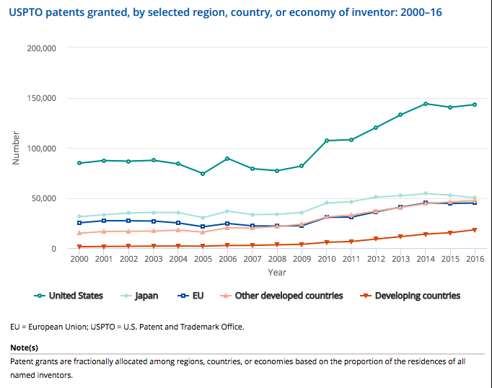

Slide 7
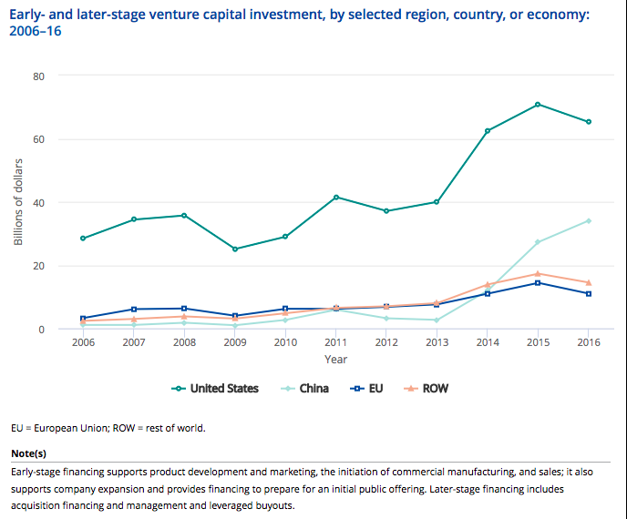

Slide 8
Investigación y desarrollo
Innovación

Slide 9


R&D expenditures: 2000–15
500
United States
450
China
400
350
EU
300
Billions of PPP dollars
250
Japan
200
150
France South Korea
Germany
100
50
India
0
2000
2002
2004
2006
2008
2010
2012
2014
Science and Engineering Indicators 2018

Slide 10
Peer-reviewed
S&E
publications:
2003–16
700
EU
600
500
United States
400
China
Other developing
Thousands
300
countries
200
Other developed countries
Japan
100
India
0
2003 2004 2005 2006 2007 2008
2009 2010 2011 2012 2013 2014 2015 2016
Science and Engineering Indicators 2018

Slide 11
U.S.
R&D
source
of
funds:
1953–2015
500
U.S. total R&D
450
Business
_{Federal government}
400
Other
dollars
350
300
current
250
of
200
Billions
150
100
50
0
1953
1955
1957
1959
1961
1963
1965
1967
1969
1971
1973
1975
1977
1979
1981
1983
1985
1987
1989
1991
1993
1995
1997
1999
2001
2003
2005
2007
2009
2011
2013
2015
Science and Engineering Indicators 2018

Slide 12


S&E
Articles
(%)
in
all
Fields
by
Top
Countries
26
24
22
20
18
16
14
12
10
8
6
4
2
0
Percentage
2006
2016
China
US
India
Germany
UK
Japan
France
Italy
S. Korea
Russia
Canada
Brazil
17

Slide 13

R&D
Intensity
(R&D/GDP):
2000–15
4.5
South Korea
4.0
Japan
3.5
Germany
3.0
2.5
United States
Percent
France
2.0
1.5
EU
China
1.0
0.5
India
0.0
2000
2002
2004
2006
2008
2010
2012
2014
Science and Engineering Indicators 2018

Slide 14

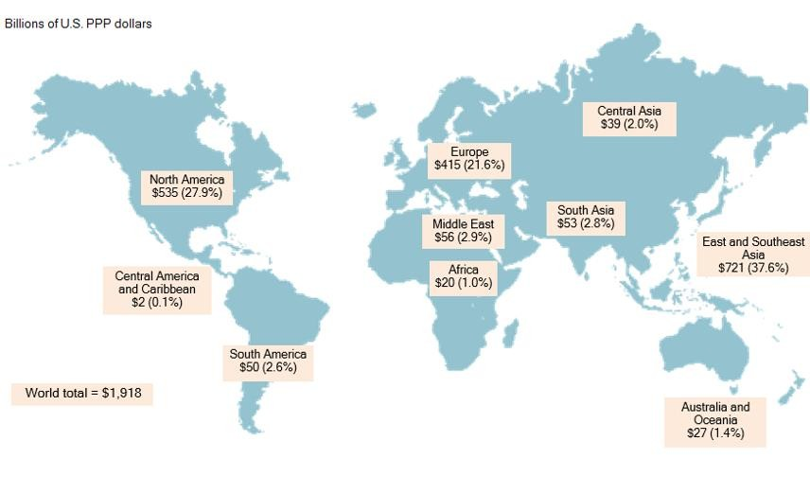
Global
R&D
Expenditures
by
Region:
2015
PPP=Purchasing Power Parity

Slide 15
What
might
the
future
hold?
Gross
Expenditures
on
R&D
600
US
550
China
Linear
(US)
500
Linear
(China
)
450
PPP in billions
(constant 2009 $)
400
350
300
250
200
Science and Engineering Indicators 2018

Slide 16
Educación
Investigación
desarrollo
Innovación

Slide 17
S&E
Bachelor’s
Degree
Awards:
2000-14
2,000
1,800
1,600
1,400
1,200
1,000
800
600
400
200
0
China
Thousands
United States EU Top 8
Japan
South Korea and Taiwan
2000
2002
2004
2006
2008
2010
2012
2014
EU Top 8: United Kingdom, Germany, France, Poland, Italy, Spain, Romania and Netherlands.
Science and Engineering Indicators 2018

Slide 18
S&E
Doctoral Degree
Awards:
2000-14
70
60
EU Top 8
50
U.S. citizens and
permanent residents
United States - total
40
China
Thousands
30
20
U.S. temporary residents
10
Japan South Korea and Taiwan
0
2000
2002
2004
2006
2008
2010
2012
2014
EU Top 8: Germany, United Kingdom, France, Spain, Italy, Portugal, Sweden, and Romania.
Science and Engineering Indicators 2018

Slide 19
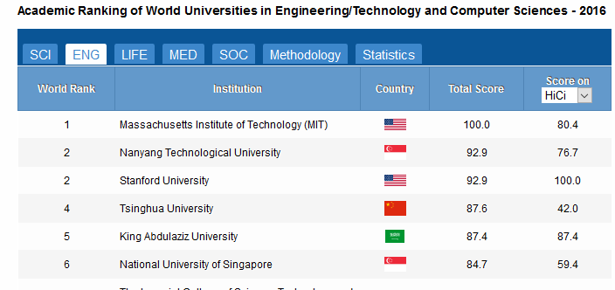

Slide 20
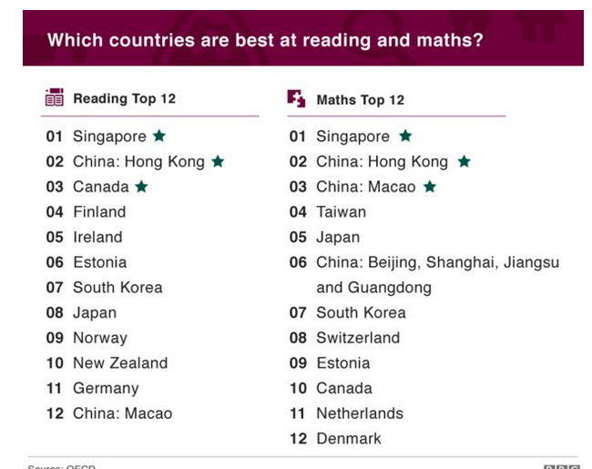
PISA Test

Slide 21
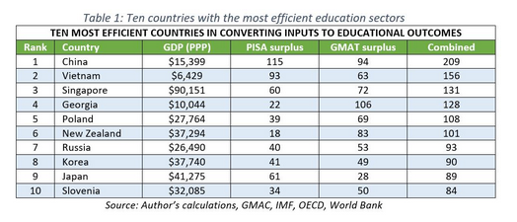

Slide 22
El cambio en educación es fácil de proponer, difícil de implementar y extraordinariamente difícil de sostener”.HARGREAVES &FINK (2006)

Slide 23
Salud

Slide 24
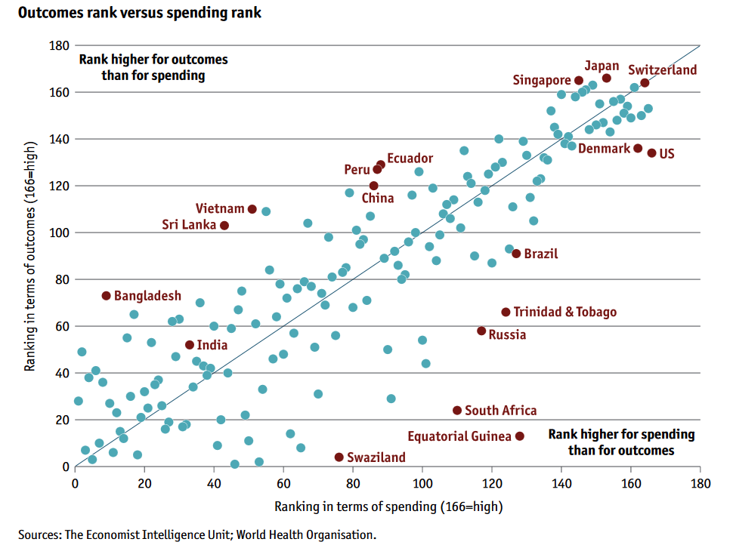

Slide 25
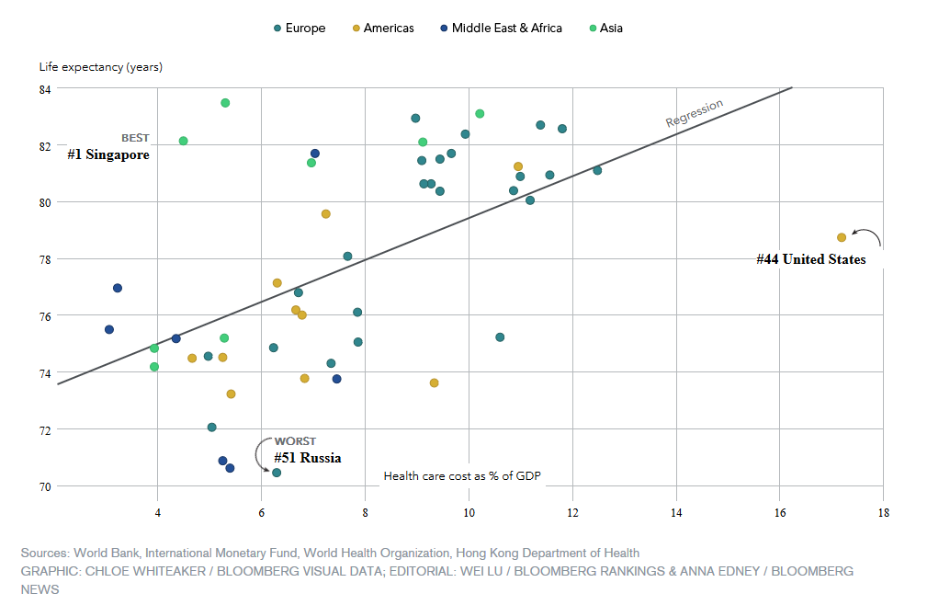

Slide 26
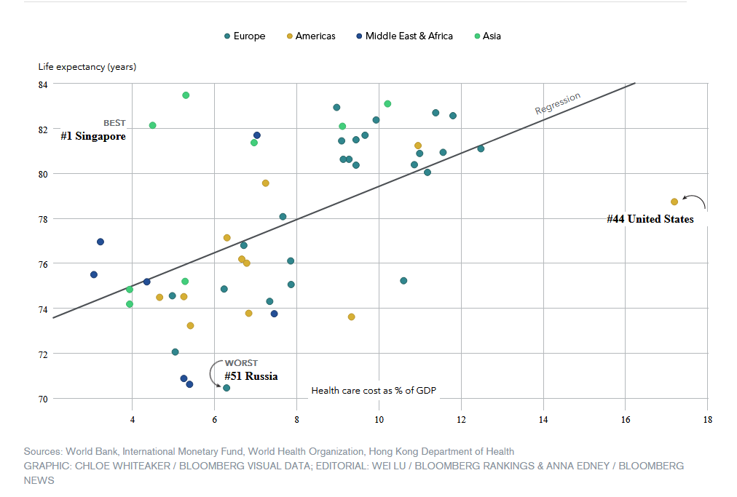

Slide 27
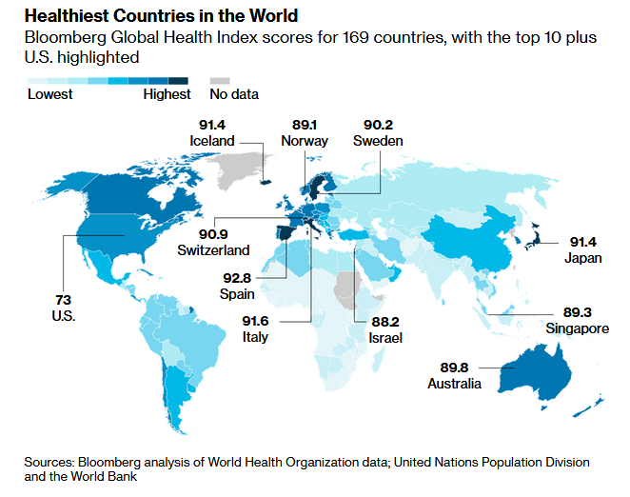

Slide 28
Salud
Educación
Investigación
Desarrollo
Innovación
Emprendimiento

Slide 29
The UN Open Working Group on Sustainable Development Goals (SDGs) has proposed as goal 9 “Build resilient infrastructure, promote inclusive and sustainable industrialization and foster innovation”. This confirms the provisions of the Lima Declaration and the relevance of ISID for the new global development architecture.
Successfully implementing ISID in our current era of globalization requires approaches that harness globally available knowledge, technology and innovation, and capital.

Slide 30
Sustentabilidad
Salud
Educación
Investigación
Desarrollo
Innovación
Emprendimiento

Slide 31


NSF
Criteria for International Engagement
Intellectual Merit, Broader Impacts Strengthened
Mutual benefit for all partners
True intellectual collaboration among all collaborators
Leverage of complementary skills, facilities, sites, resources
Active engagement of students and early career researchers

Slide 32

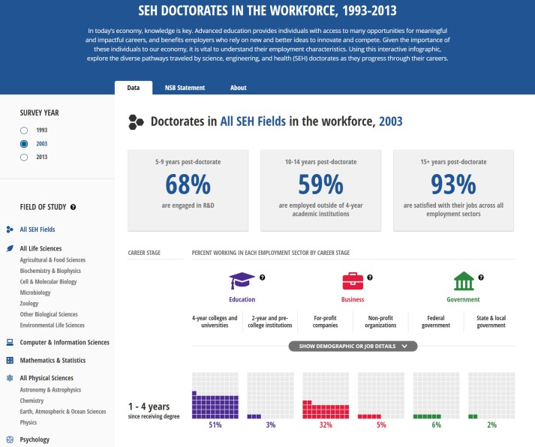
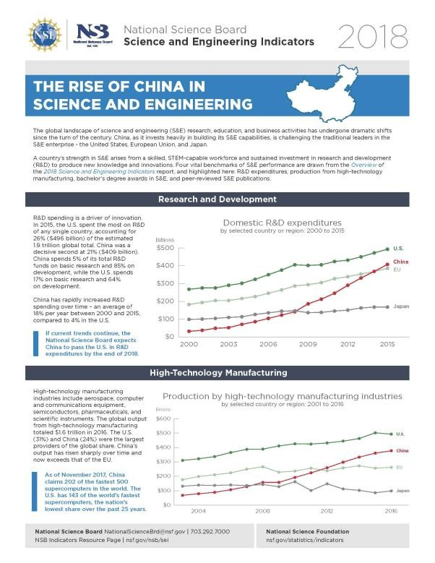
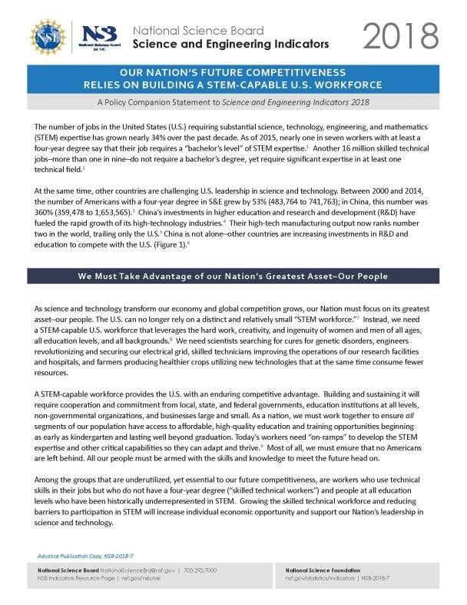
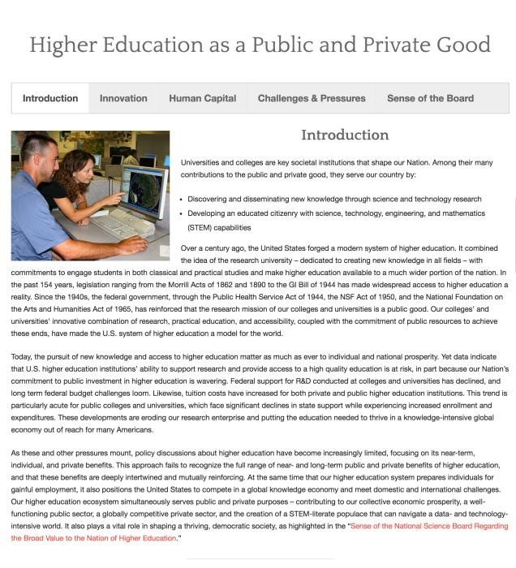
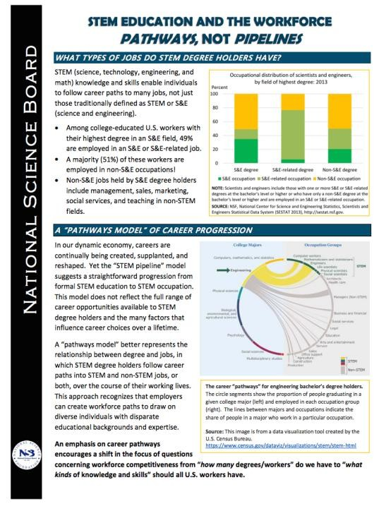
Policy Products

Slide 33
Sistemas Nacionales de Innovación

Slide 34
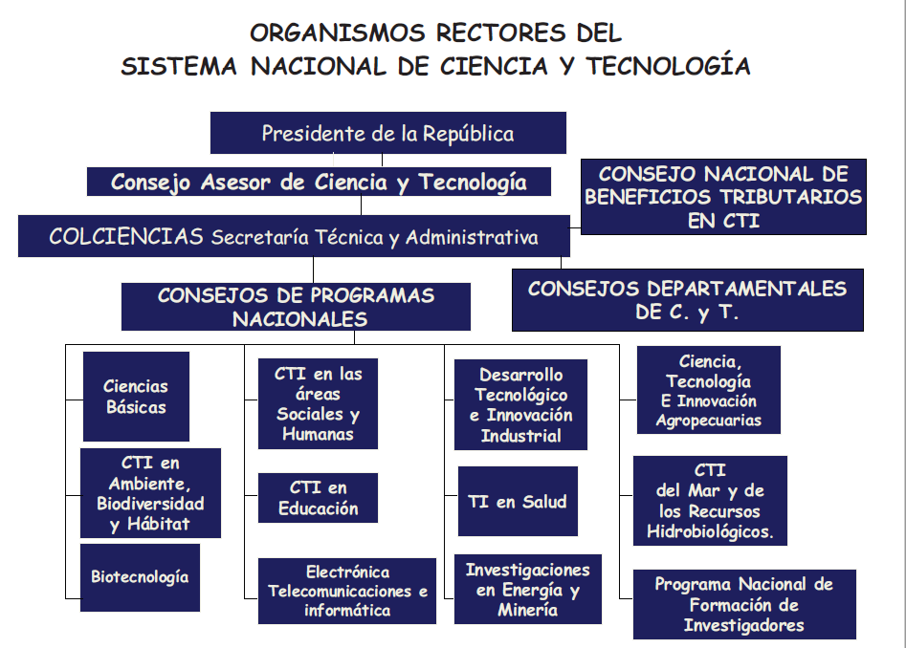
Colombia

Slide 35
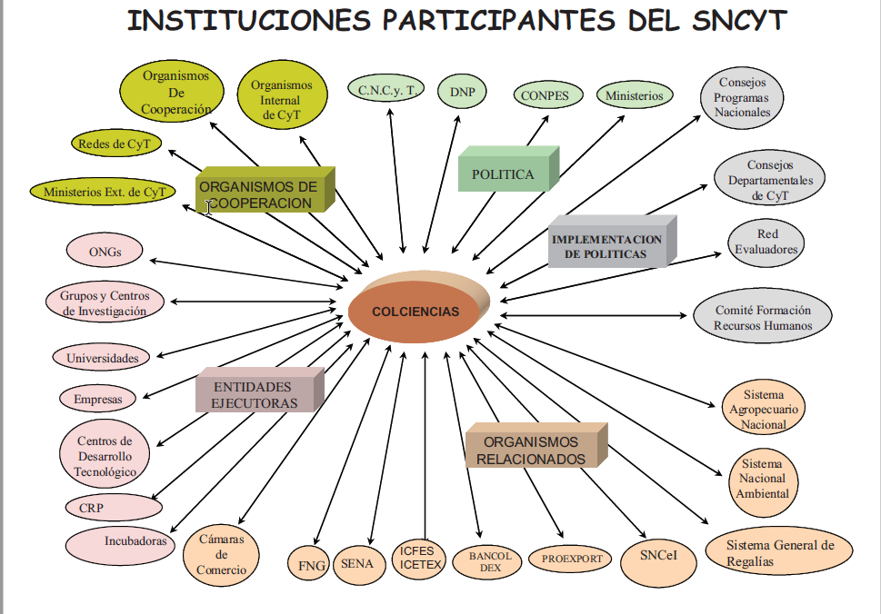
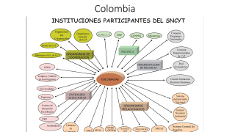
Colombia

Slide 36
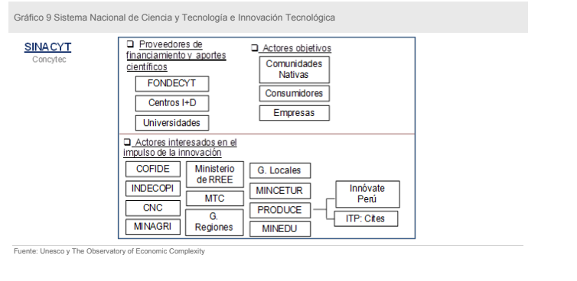
Perú

Slide 37
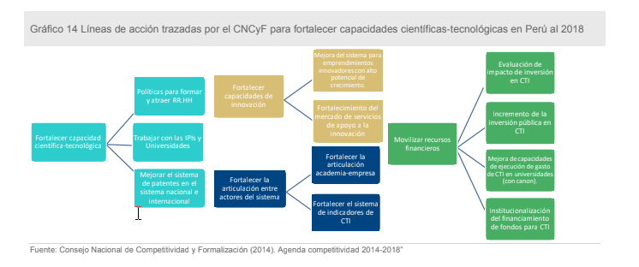
Perú

Slide 38
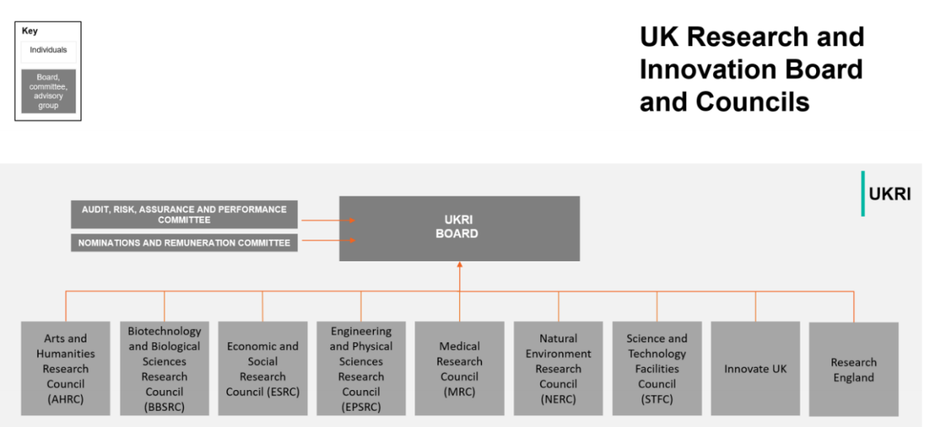
Inglaterra

Slide 39
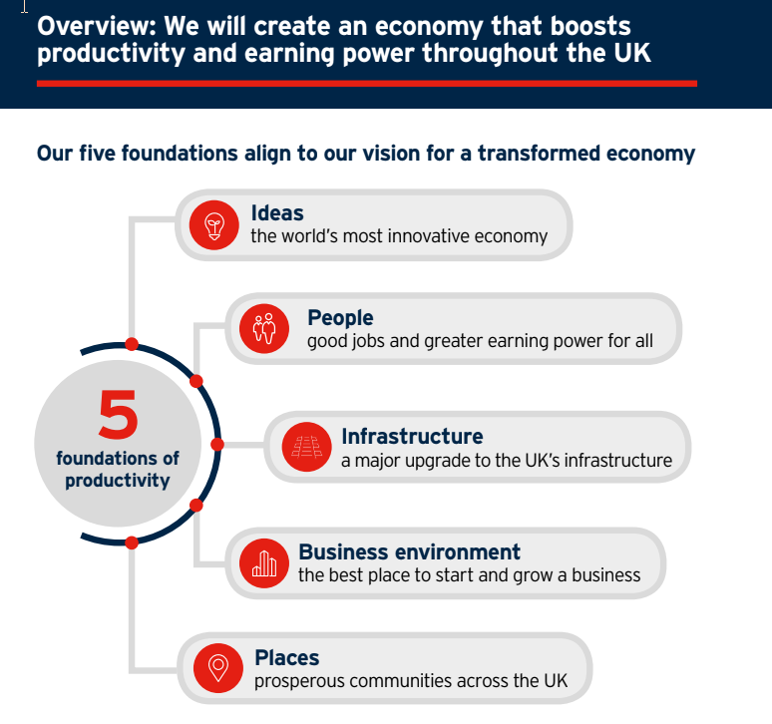
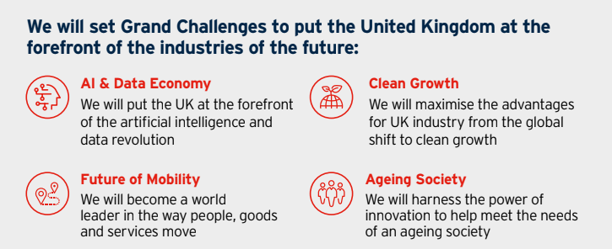
Inglaterra: Politica Industrial

Slide 40
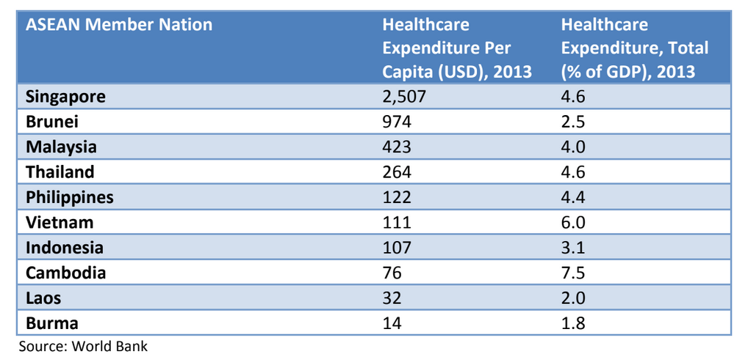

Slide 41
SINGAPORE - Singapore has been ranked No. 2 in the world for health-care outcomes, according to a report by The Economist Intelligence Unit (EIU). The Republic followed closely after Japan. South Korea was placed third. The report "Health outcomes and cost: a 166-country comparison" assesses the efficiency of health-care systems globally, looking at value for money.

Slide 42
